Slide 1
An Eclectic Mary Oliver Outlook: Personal Interpretations and Other types of Media
Group 22
Danielle Morrison
Robert Mclaren
Jonas Friedel
Agnes Pangilinan

Slide 2
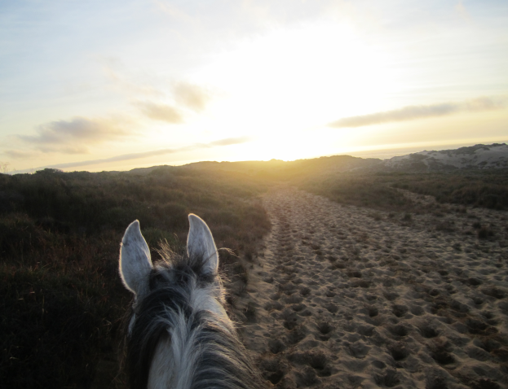
The Horse
All summer we faded
into the bits of mulled over soil
that became betrothed to the soles of our feet
Damp footprints of marsh and sod
that would tell tale of our existence in an hour’s time
But we are never as stationary as the things we left behind
From what grew brown from the ground
came up white
Like flowers towards the sun
lost in the brightness
of the psalms of the day
where everything was safe
And we had nothing to hide

Slide 3
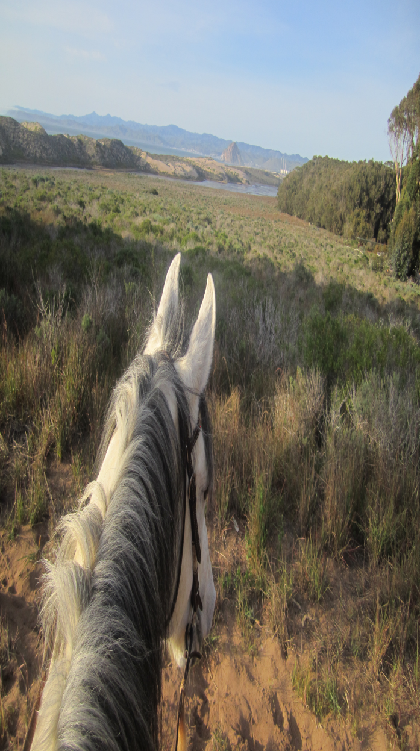
In your mismatched gray hues
I could let fall
the walls that I'd built
to keep out the world
because cross-hairs left
less space for me to slip
In the quiet of the day
where the world has ceased to turn
and equilibrium was but a series of sounds
when we tried to find
who we thought we ought to be
We paused
Because word holds more meaning
in the lading of an hour

Slide 4
I stop and stare
At my faithful companion
He seems so simple, yet there is so much more.
From afar he looks peaceful
Calmly eating grass
But up close I see
His muscles quiver, his eyes flash
But I know under that brute strength
His soul is good
And he will never fail me
When legs fail to hold
we look to brace
in the places we have yet to find
but the answer is as tangible as rain
It is in nature’s companionship that we ascend
to greatness

Slide 5
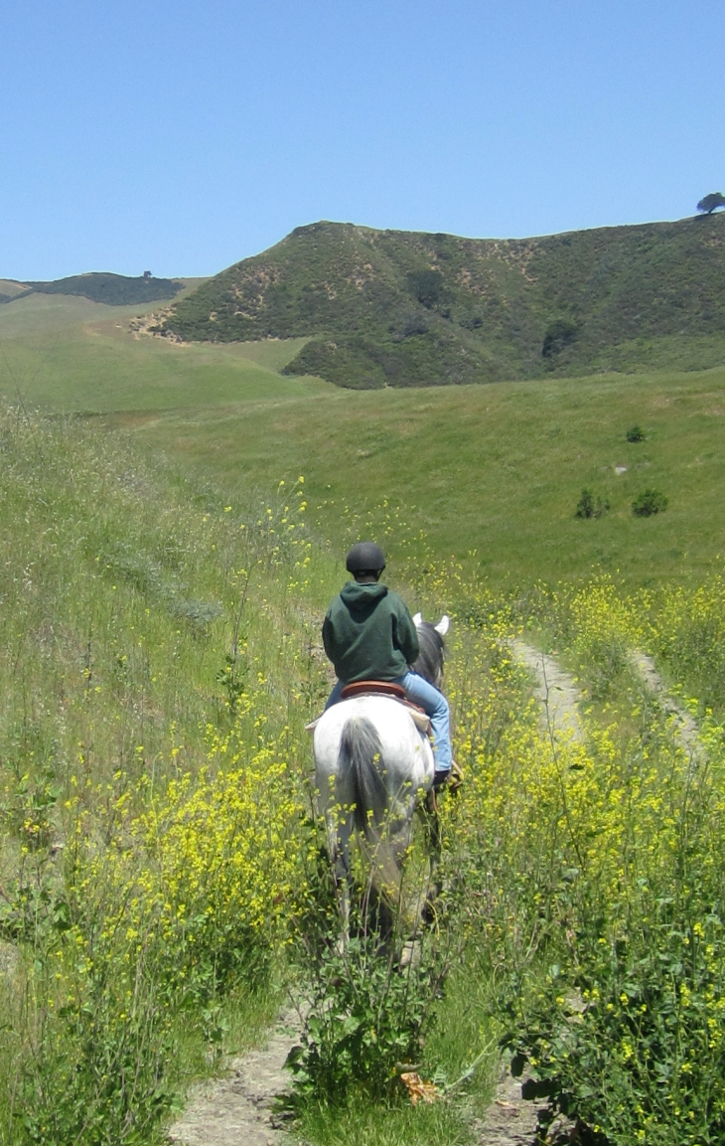
All summer we faded
But some of us were made to stand
And though the legs were not my own
I found myself
in the daylight
In the companionship
of a girl and a horse

Slide 6
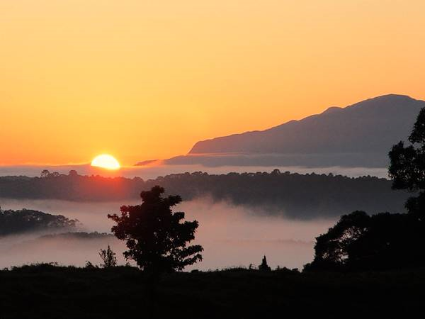
The Sun
Have you ever seen anything in your life more wonderful
than the way the sun, every evening, relaxed and easy, floats toward the horizon

Slide 7
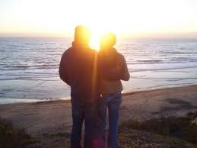
and into the clouds or the hills, or the rumpled sea, and is gone-- and how it slides again
out of the blackness, every morning, on the other side of the world, like a red flower

Slide 8
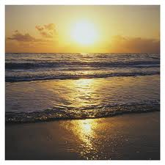
streaming upward on its heavenly oils, say, on a morning in early summer, at its perfect imperial distance-- and have you ever felt for anything such wild love-- do you think there is anywhere, in any language, a word billowing enough for the pleasure
that fills you, as the sun reaches out, as it warms you

Slide 9
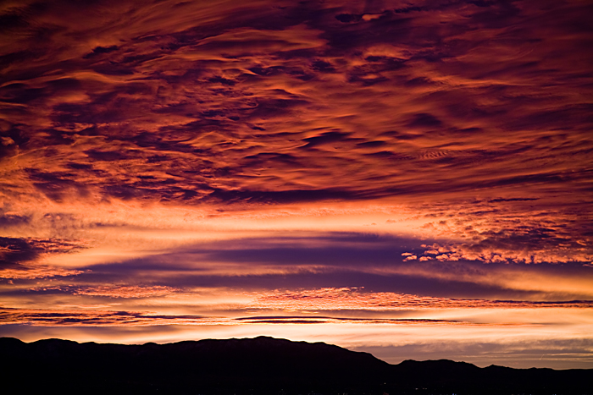
as you stand there, empty-handed-- or have you too turned from this world--
or have you too gone crazy for power, for things?

Slide 10
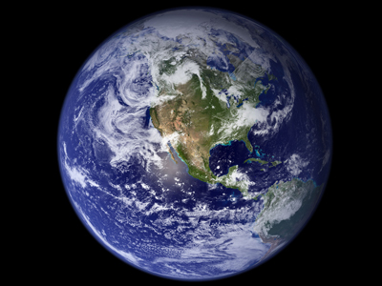
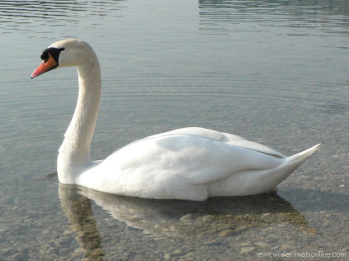
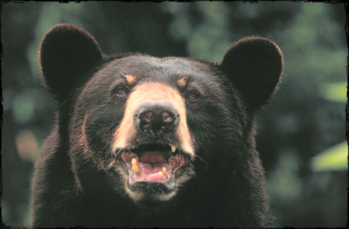
The Summer Day
Who made the world?
Who made the swan, and the black bear?
Who made the grasshopper?
This grasshopper I mean—
the one who has flung herself out of the grass,
the one who is eating sugar out of my hand,
who is moving her jaws back and forth instead of up and down—

Slide 11
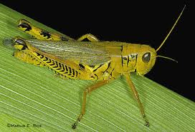
Now she lifts her pale forearms and thoroughly washes her face.
Now she snaps her wings open, and floats away.
I don’t know exactly what a prayer is.
I do know how to pay attention, how to fall down
into the grass, how to kneel down in the grass,

Slide 12
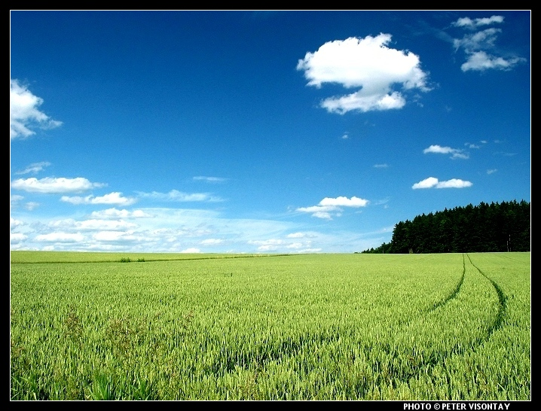
how to be idle and blessed, how to stroll through the fields,
which is what I have been doing all day.
Tell me, what else should I have done?
Doesn’t everything die at last, and too soon?
Tell me, what is it you plan to do
with your one wild and precious life?

Slide 13
Mary Oliver’s “The Sun” and the Beatles “Here Comes The Sun”
Comparing and contrasting:
Both were pleasant reminders that even in the darkest times that things can get better or rather, even during “the coldest and loneliest winters”(The Sun) and “the blackest nights”(Here Comes the Sun), “the sun will rise again” and life will return to the land.
Both share many Romantic and Contemporary themes that were often found in the 60’s.
The Sun, the center of the universe, gives us light, energy, and life.
Darkness, greed, and depravation cloud our judgment, corrupt us, and “drives us crazy”(The Sun).

Slide 14
Take Away Message from The Summer Day
Lamb and Tyger
Experience and enjoy life right down to the little things
Virginia Wolfe echo
Notice the movement of the ant and the way they move their antennas

Slide 15
Planet Earth
http://www.youtube.com/watch?v=7HfeBP3vaEI&feature=related
4:21-5:30

Slide 16
Take away from Mary Oliver
"... or have you too gone crazy for power for things?“
(The Sun)
"Doesn't everything die at last, and too soon? Tell me what is it that you plan to do with your one wild and precious life?"
(The Summer Day)
…Thank you!

