Slide 1
World War One Poets
Poems:
The Soldier by Rupert Brooke
They by Siegfried Sassoon
Songs:
Hero of War: Rise Against
Survivor Guilt: Rise Against
Presentation by:
Deniz Doluca, Jennifer Kuruma, Cecilia Hangad, Chris

Slide 2
If I should die, think only this of me
That there’s some corner of a foreign field
That is for ever England. There shall be
In that rich earth a richer dust concealed;

Slide 3
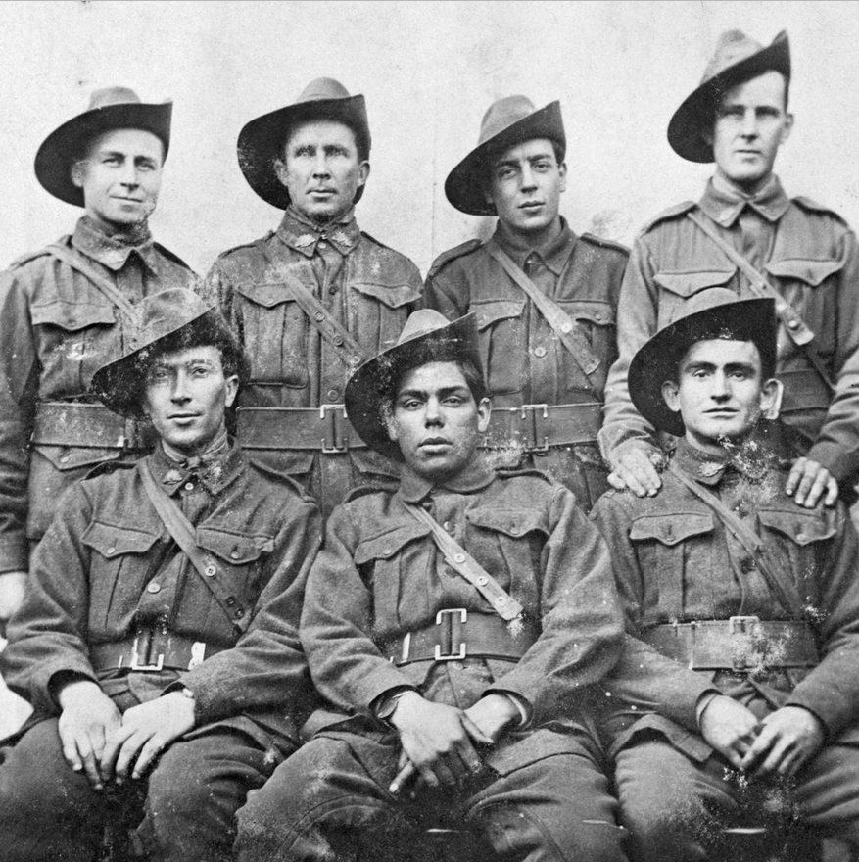

Slide 4
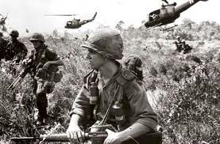

Slide 5
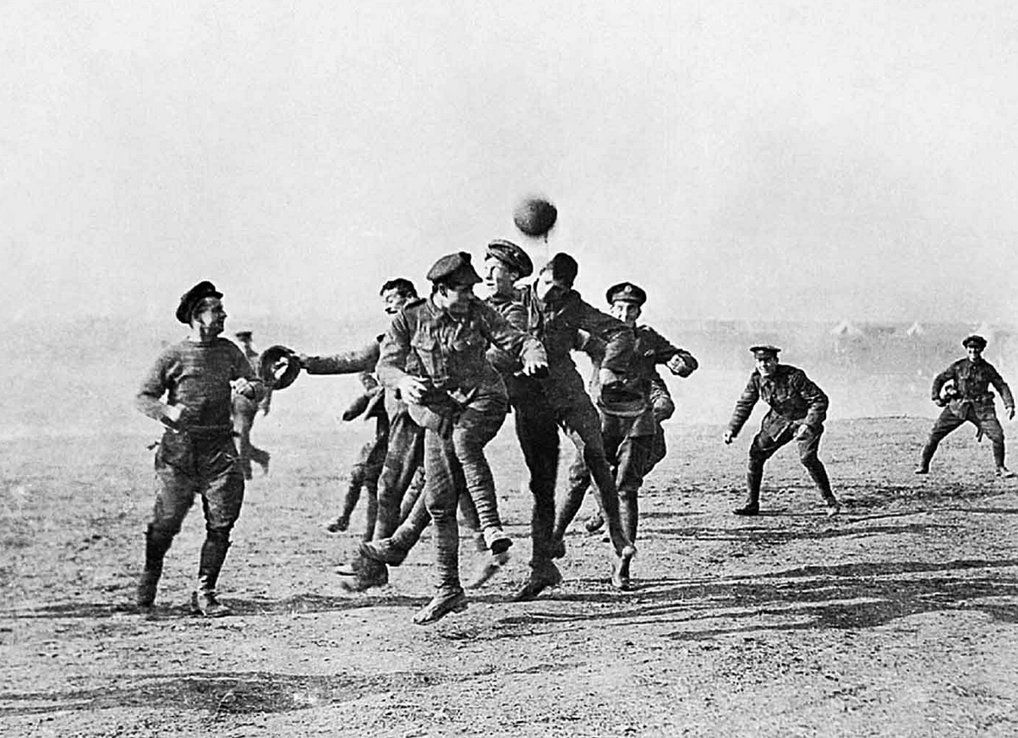
A dust whom England bore, shaped, made aware,
Gave, once, her flowers to love, her ways to roam,
A body of England’s, breathing English air,
Washed by the rivers, blest by suns of home

Slide 6
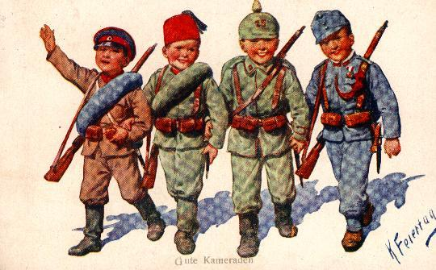

Slide 7
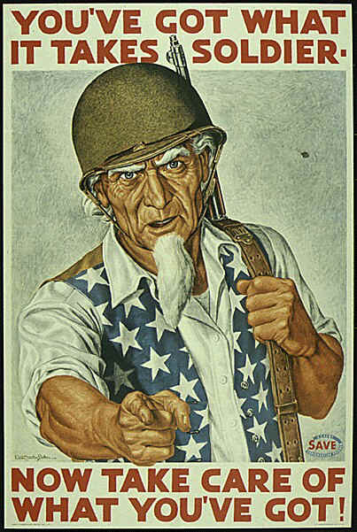

Slide 8
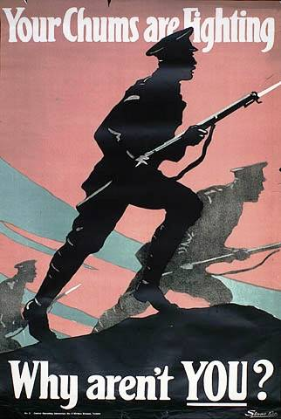
And think, this heart, all evil shed away,
A pulse in the eternal mind, no less
Gives somewhere back the thoughts by
England given;

Slide 9
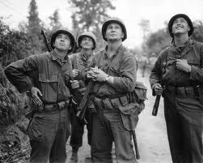

Slide 11
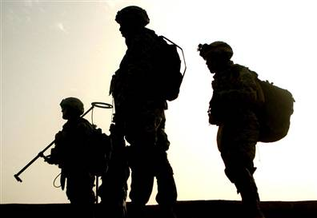
Her sights and sounds; dreams
happy as her day;
And laughter, learnt of friends;
and gentleness,
In hearts at peace,
under an English heaven.

Slide 12
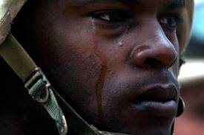
The Bishop tells us: “When the boys come back
They will not be the same; for they’ll have fought
In a just cause: they lead the last attack

Slide 13
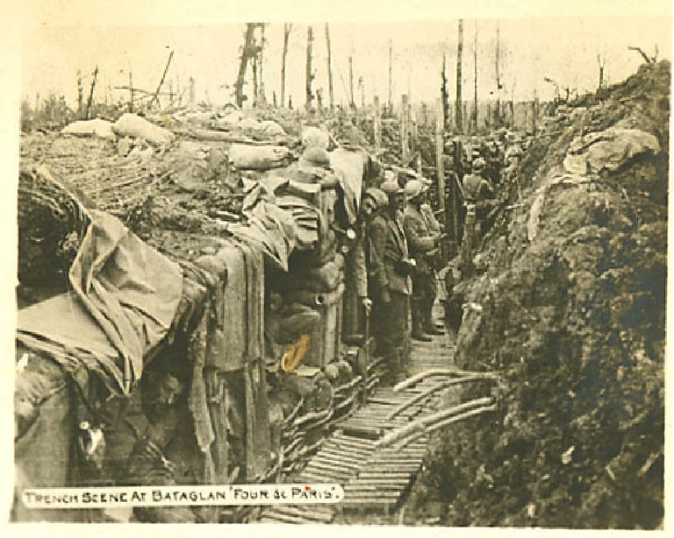

Slide 14
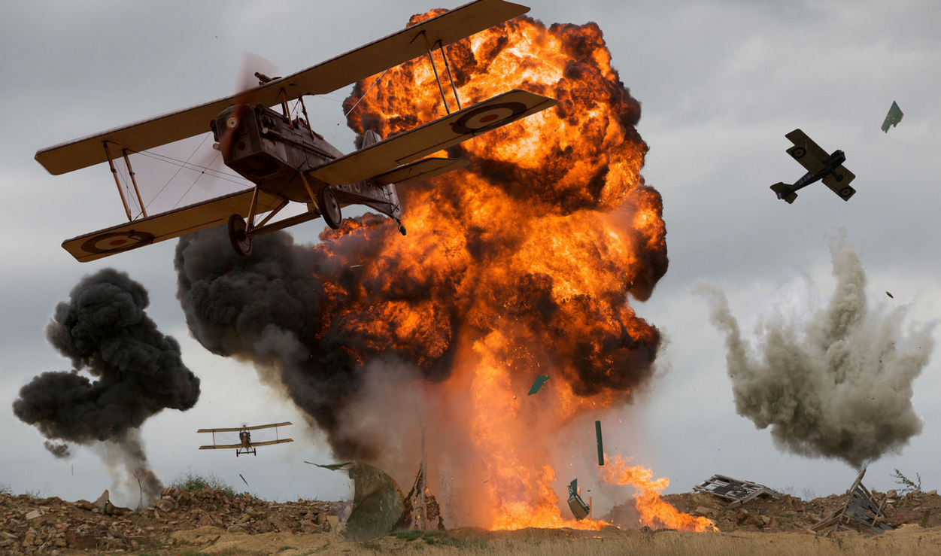

Slide 15
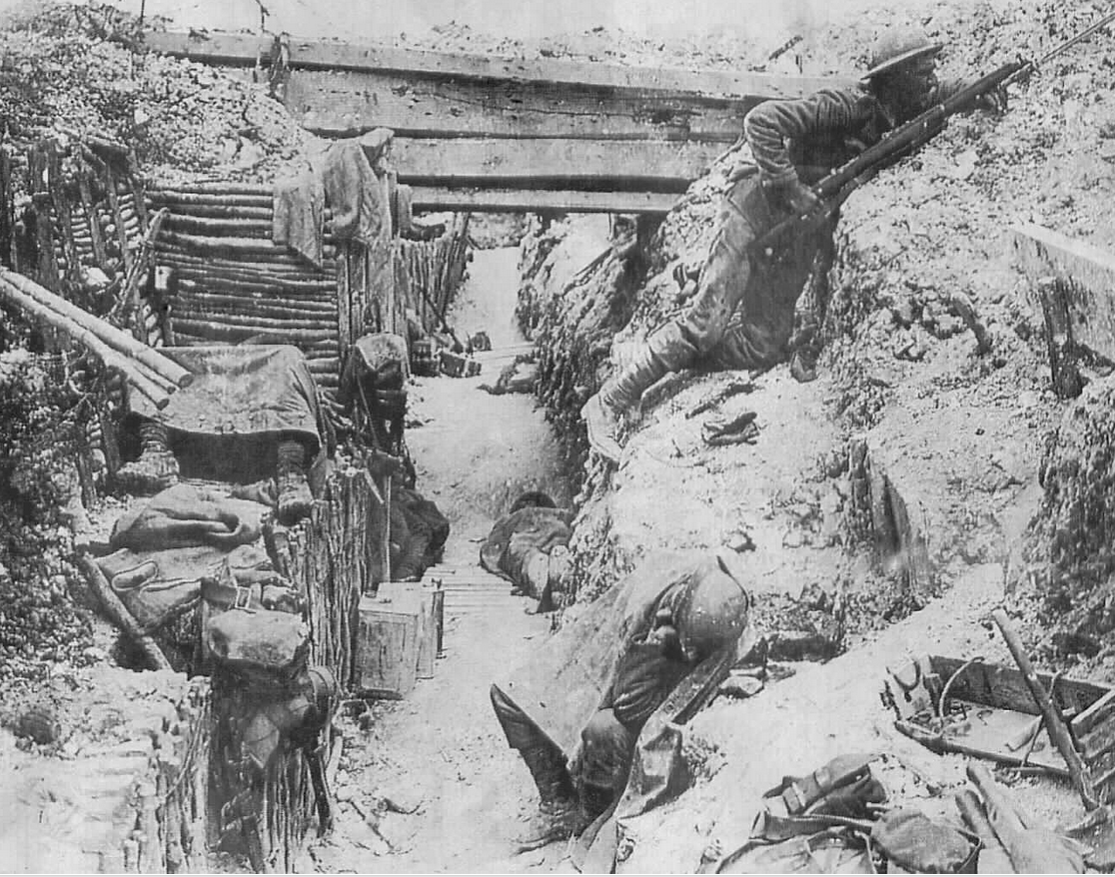
On Anti-Christ; their comrade’s blood has bought
New right to breed an honorable race.
They have challenged Death and dared him face to face

Slide 16
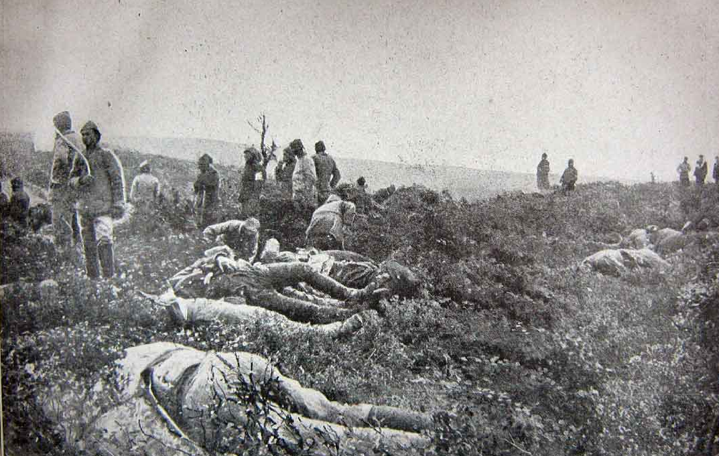

Slide 17
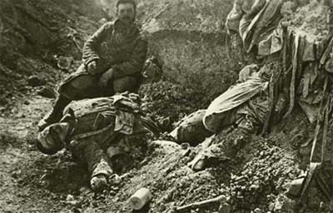

Slide 18
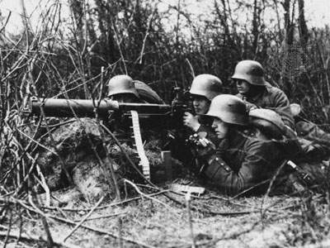
‘We’re none of us the same!’ the boys reply.
‘For George lost both his legs; and Bill’s stone blind,
Poor Jim’s shot through the lungs and like to die;

Slide 19
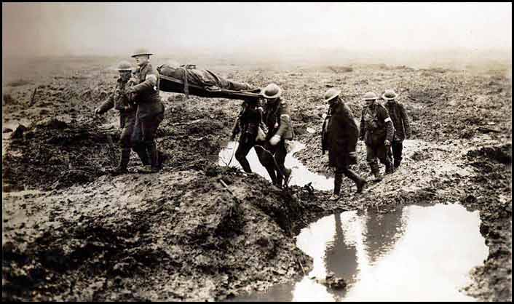

Slide 20
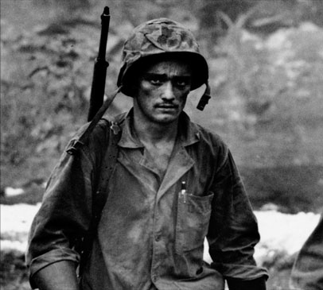

Slide 21
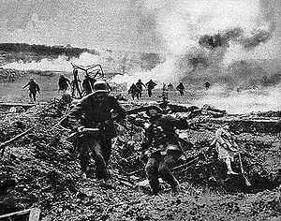

Slide 22
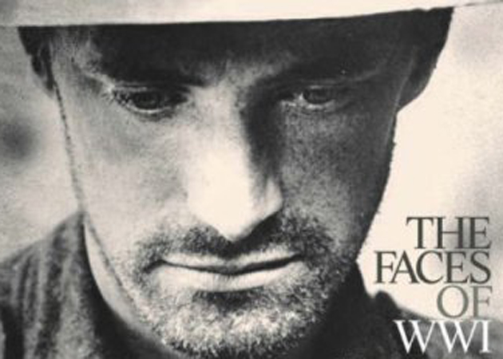
And Bert’s gone syphilitic: you’ll not find
A chap who’s served that hasn’t found some change.’
And the bishop said: ‘The ways of God are strange!’

